Slide 1

EV Hub
EVHub - The Ultimate EV Companion App
Overview of EVHub
EVHub is a mobile application designed to help users explore and navigate the world of electric vehicles (EVs).

Slide 2

Purpose:
EVHub allows users to find nearby charging stations by entering their location, with stations displayed on a map for easy navigation.
It also provides EV news, cost estimation tools, a marketplace, a community forum, and a comparison tool for electric and fuel-powered vehicles.
Technology Stack:
Key Features of EVHub:
Latest EV Updates: Displays news and updates on electric vehicles.
Charging Station Locator: Search for nearby charging stations with map navigation.
EV Marketplace: Buy, sell, and explore electric vehicles and related products.
Cost Estimation: Estimate the total cost of owning an EV.
Fuel vs Electric Comparison: Compare electric vehicles with fuel-powered cars.
Firebase Authentication: Secure user registration and login.
Community Forum: Connect with EV enthusiasts and share experiences.
Dark/Light Theme: Option to switch between dark and light modes.
Language Support: Multiple language options for a personalized experience.
Profile Management: Manage user profile and preferences.
Contact Support: Reach out for support, feedback, or inquiries.

Slide 3

Technology & Architecture
Flutter: Cross-platform UI toolkit for building high-performance, natively compiled mobile apps.
Dart: Programming language for Flutter, optimized for fast performance and smooth user experiences.
Firebase:
Authentication: Secure user login and registration via email and password.
APIs:
Open Charge Map API: Fetches data for nearby charging stations.
NewsAPI: Retrieves the latest electric vehicle news and updates.
Google Maps API: Provides map functionality for locating and navigating to charging stations.
JSON: Data format used for API communication, especially for dynamic content like EV Marketplace listings.

Slide 4
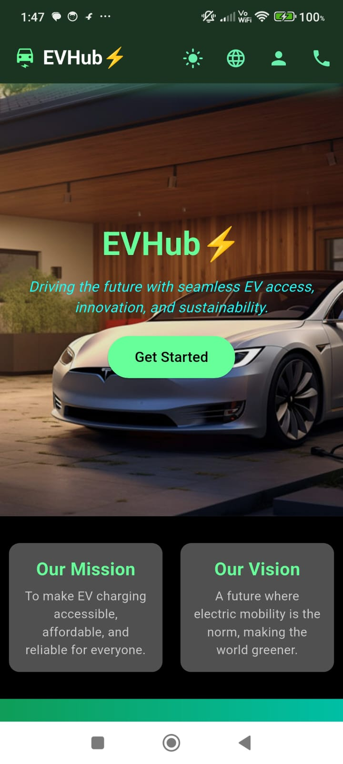
Welcome page
This is the first screen users see when they open the EV Hub app. It provides a brief introduction to the platform and its key features .
When users click "Get Started," they are redirected to the login or sign-up page to proceed with accessing the app.

Slide 5
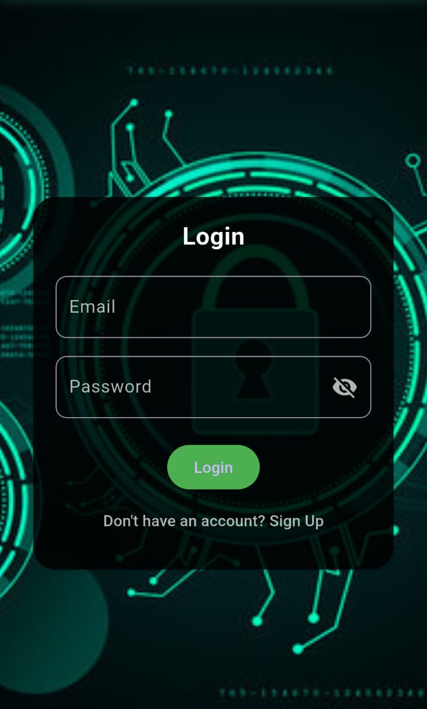
Login page
The login page allows users to register if they don't have an existing account. Upon registration, user credentials (email and password) are securely stored in Firebase for authentication. Existing users can log in using their registered credentials to access the app.

Slide 6
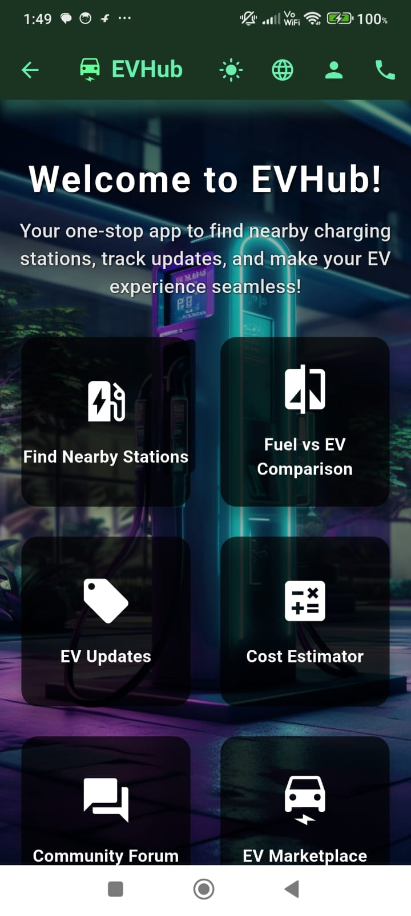

Home Page
Home page offers features like finding nearby charging stations, cost estimator, EV updates, and a community forum,Fuel vs EV comparison,EV marketplace for a seamless EV experience.

Slide 7
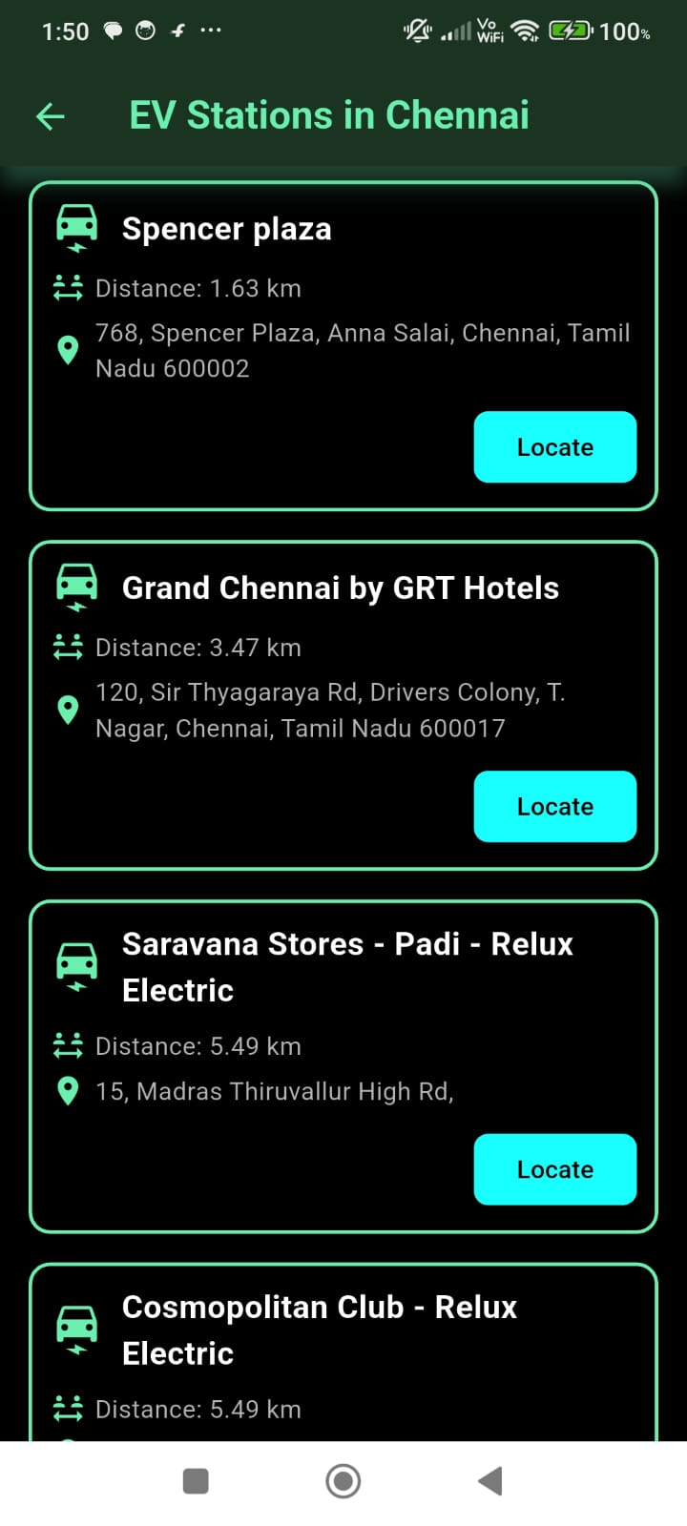
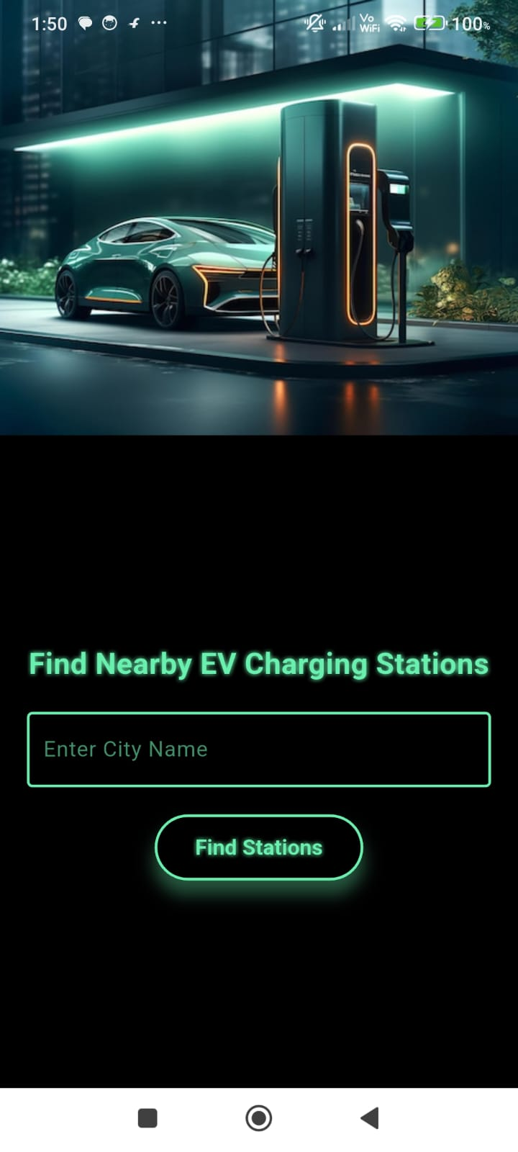
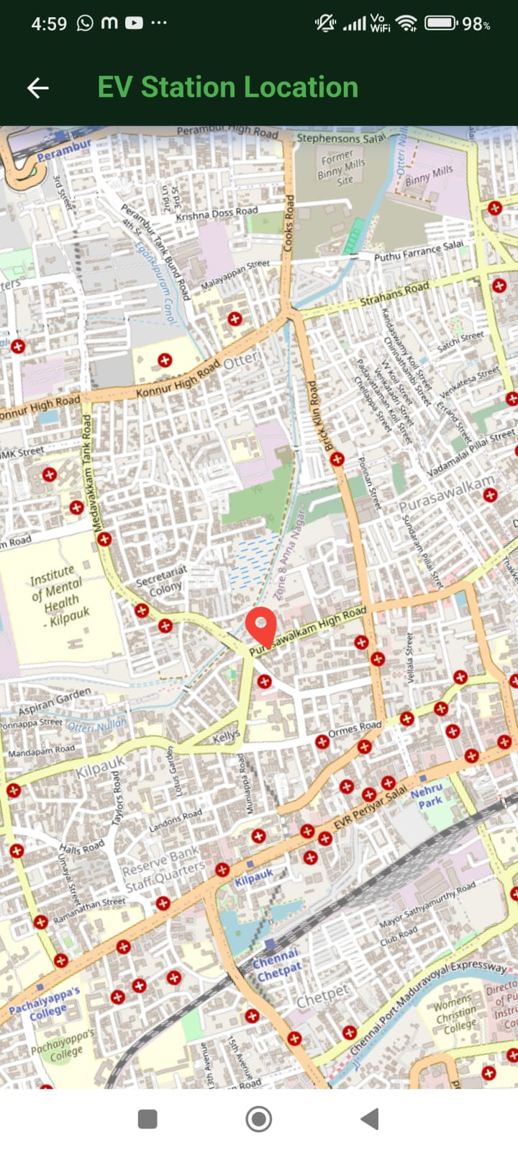
Charging Stations
Users can find nearby charging stations by entering their location, with real-time availability displayed. Tapping on a station shows its location on a map with a pin for easy navigation. This feature provides access to charging stations worldwide, including locations like Indonesia, China, Chennai, and Goa.

Slide 8
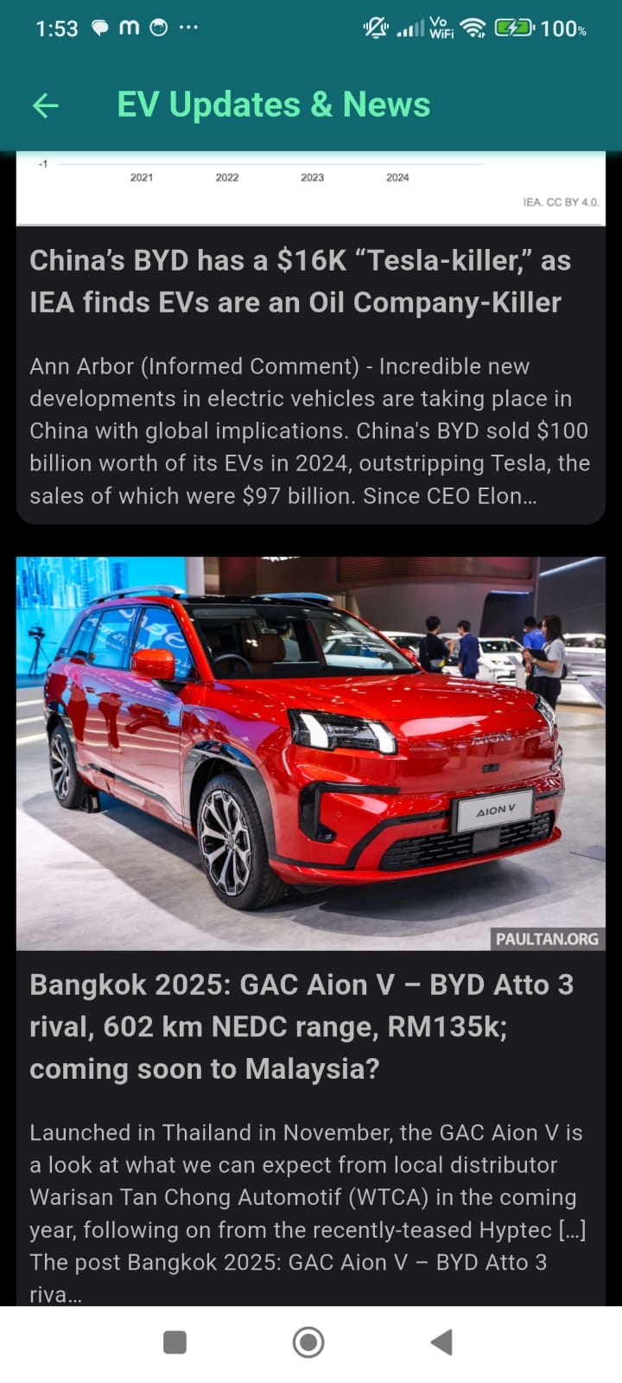
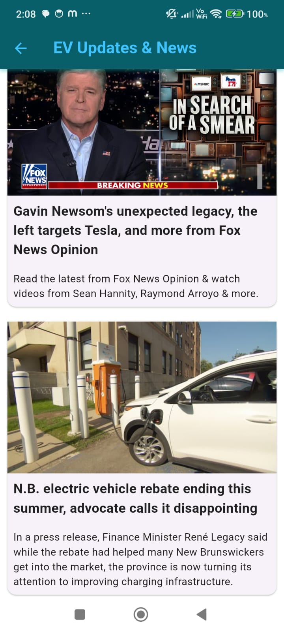
EV Updates
The EV Updates page provides the latest EV news, keeping users informed about new electric vehicle models, industry trends, and technological advancements. Users can access real-time updates, ensuring they stay current with the rapidly evolving electric vehicle market.

Slide 9
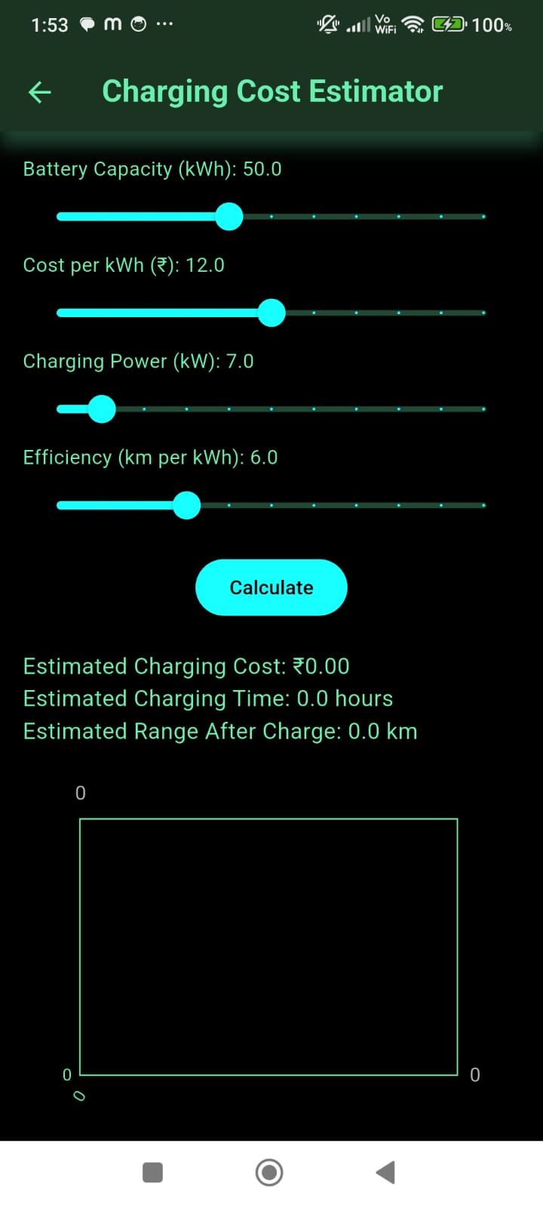
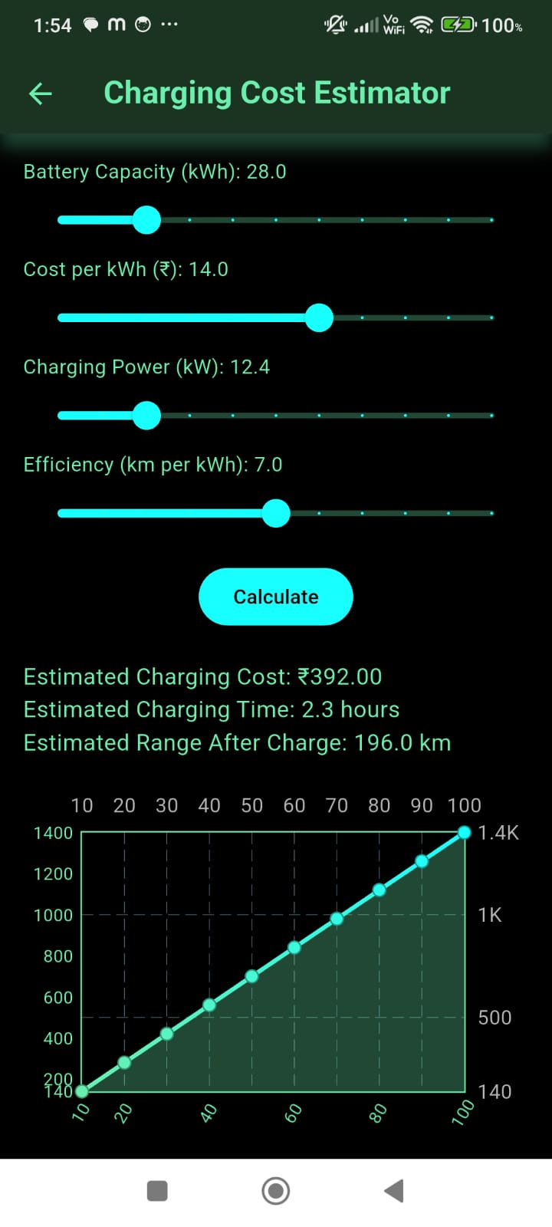
Cost Estimation
Estimate your EV costs, compare with traditional fuel expenses

Slide 10
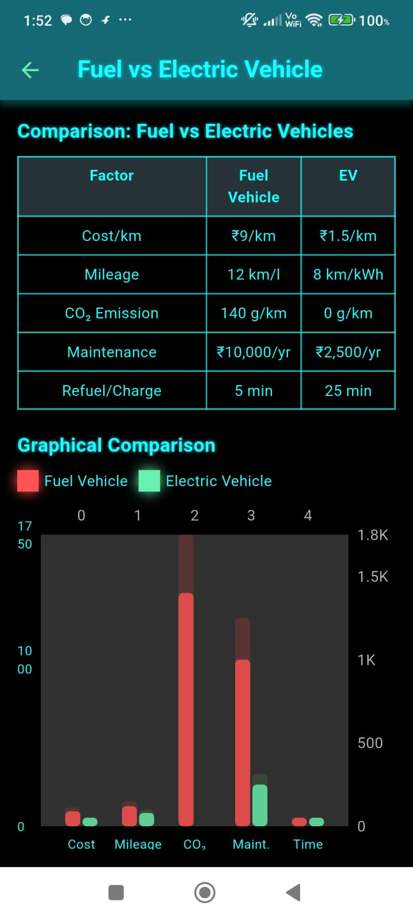
EV vs Fuel
EV vs Fuel - Analyzing efficiency, cost, and long-term benefits

Slide 11
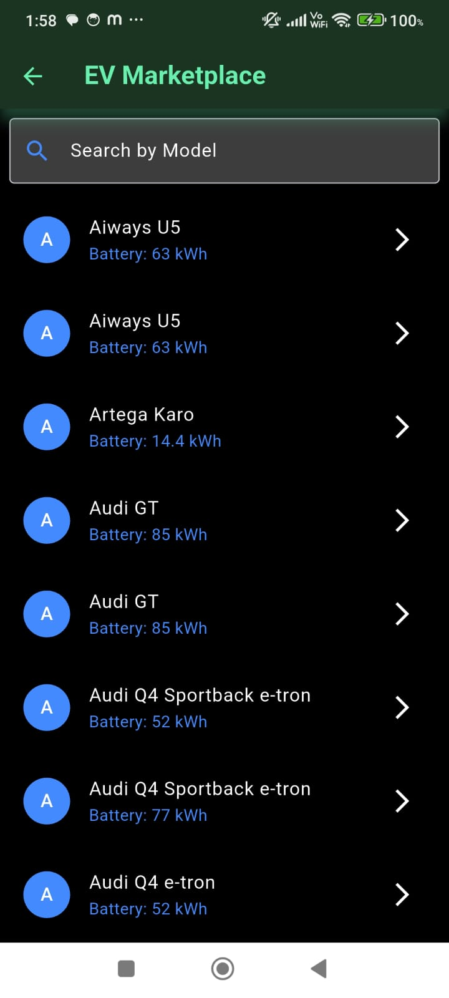
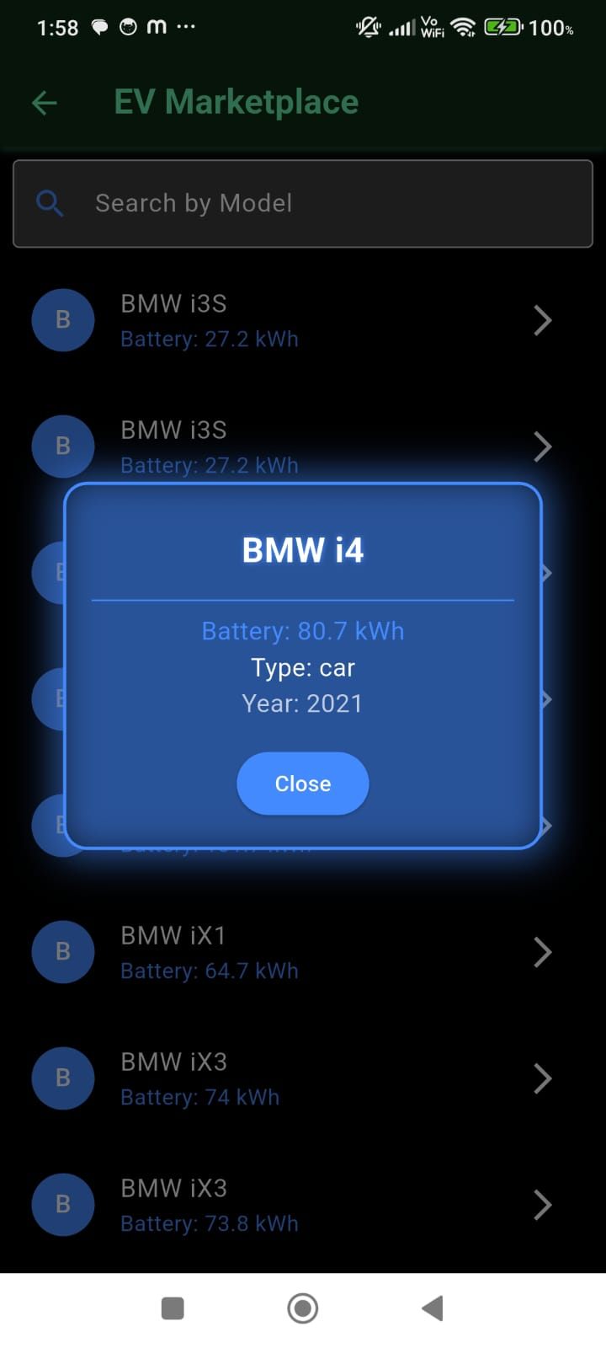
EV Marketplaces
Explore EV marketplaces to buy, sell, and compare vehicles

Slide 12
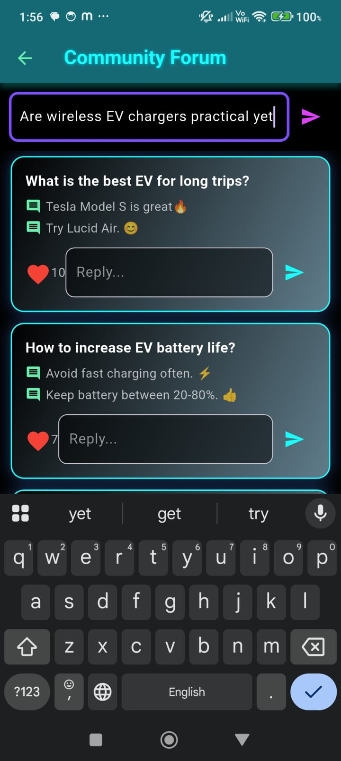

Community Forum
Join discussions, share experiences, and connect with EV users

Slide 13
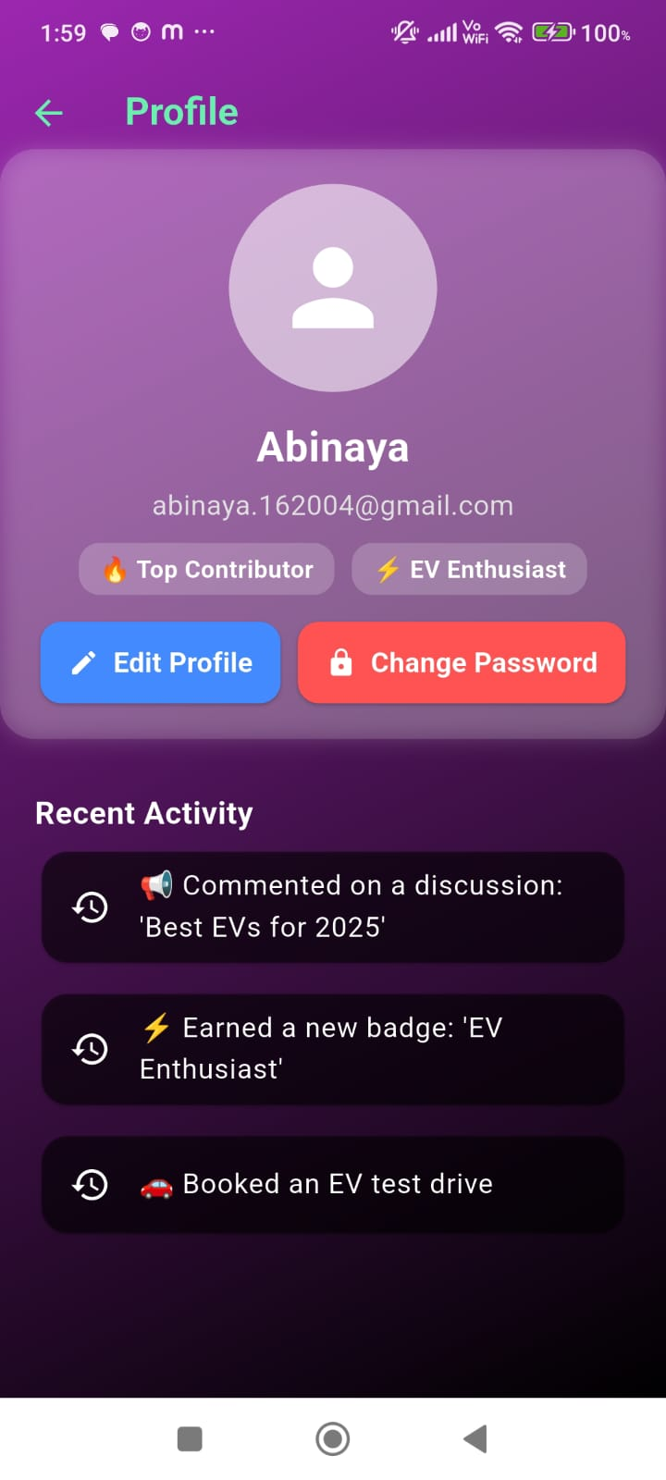
User Profile Management
Manage your profile, preferences, and personalized settings

Slide 14
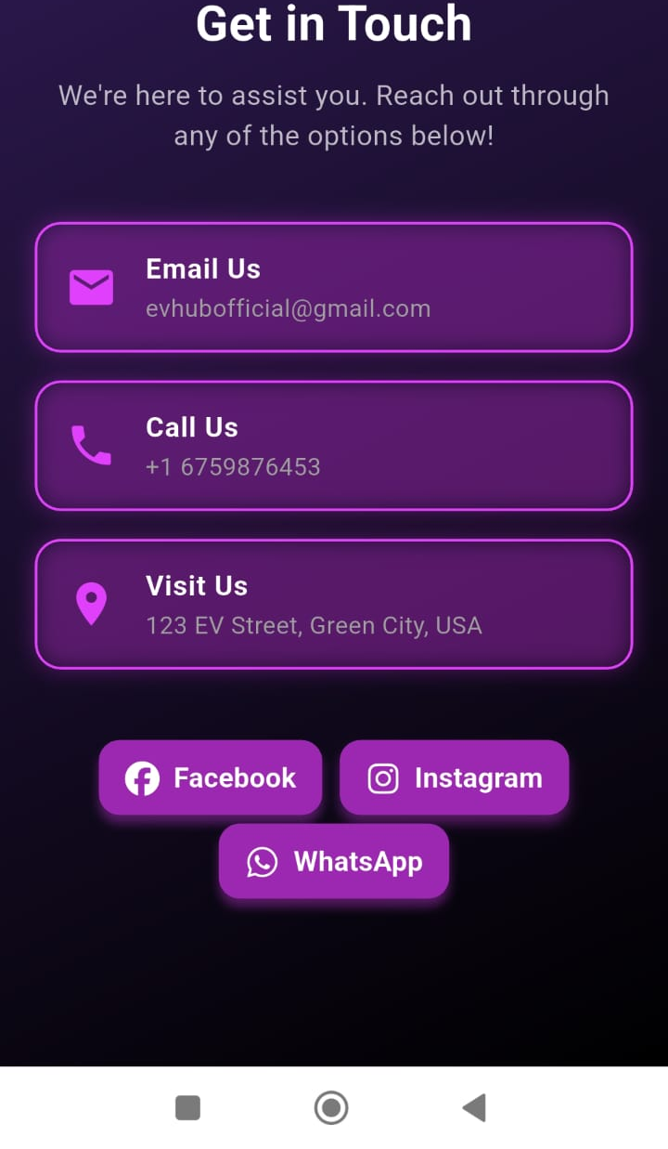

Contact & Support
Get in touch with customer support for assistance

Slide 15

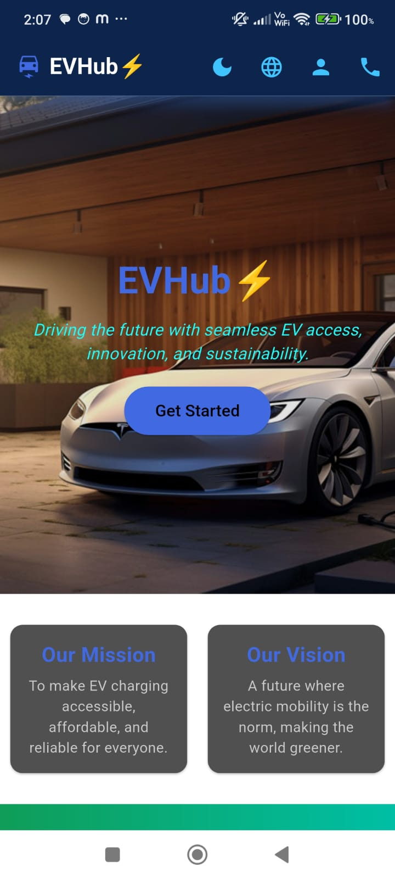
Theme Customization
Customize app themes and personalize
your experience

Slide 16
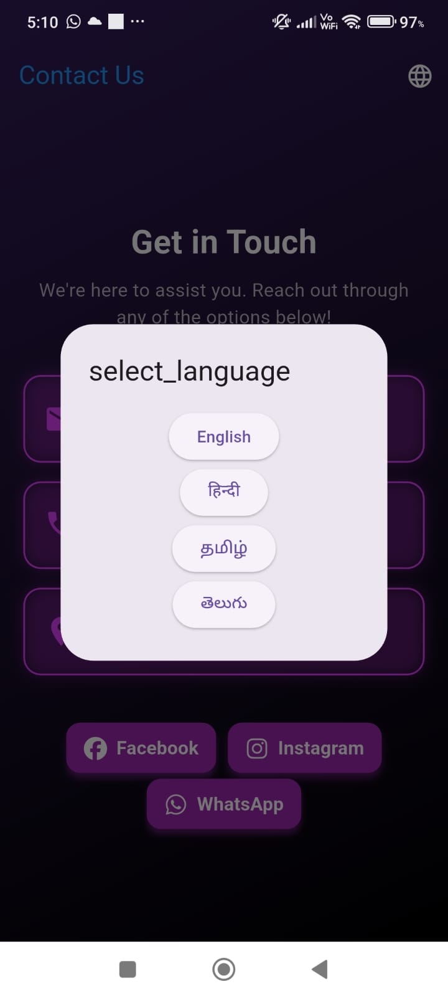

Language Support
Multiple language support for a global user experience

Slide 17
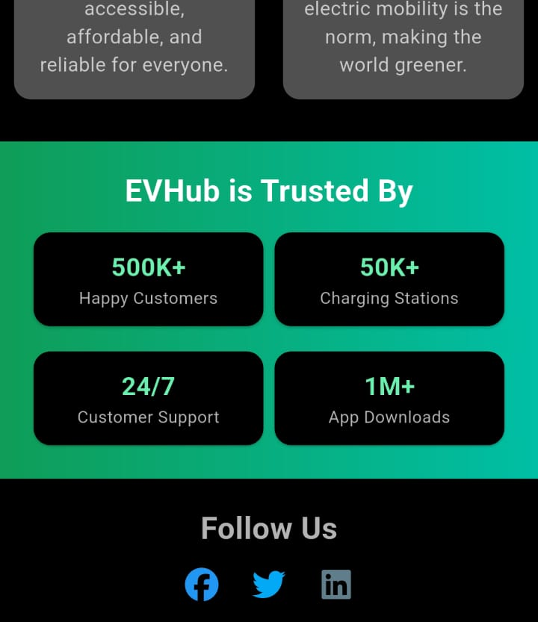
Conclusion
A summary of EV Hub's impact and future potential

Slide 18

Thank You
Thank you for exploring EV Hub - Drive into the future!

